Slide 1

Character
NURTURING
LEADERSHIP
EUROPEAN NAZARENE COLLEGE FACULTY FORUM
February 1 & 2, 2022

Slide 2

Three Sessions
Session One: The Need for Leadership Character
Session Two: Leadership Character and Conflict
Session Three: How to Nurture Leadership Character

Slide 3
“How do I build up the trust of the people who work with me?”
Two Stories
1. A Letter

Slide 4

Story One
Response to letter from a MVNU graduate
1. Is my behavior predicable or erratic?
2. Do I communicate clearly or carelessly?
3. Do I treat promises seriously or lightly?
4. Am I forthright or dishonest?

Slide 5
“…leading others begins with leading myself.”
Two Stories
2. Myanmar Evangelical
Alliance Seminar

Slide 6
1. Consistency and Integrity;
Story Two
Outline of Yangon, Myanmar Evangelical Alliance Seminar .
2. Communication and Transparency;
3. Confidentiality and Courageous Conversations;
4. Competence and Humility; and
5. Caring Relationships, Discipline, and a “Non-anxious” presence.

Slide 7
Leadership Character
Leadership Role Models
Who are your leadership role models?
What are the character qualities and values
you most admire in these individuals?
How do you feel when you leave their presence?
How do these heroes exemplify ethical behavior for you?
Thesis for these sessions: For the students you teach or faculty you lead, you can become leadership role models who exemplify, in word and deed, the very character qualities and values you most admire in others.

Slide 8
Leadership Character
"Leadership Character” Defined
What is ”Leadership Character”?
“LEADERSHIP CHARACTER refers to the qualities or values
that shape the leader’s motivations, responses, and moral actions
in the home, on the job, and in cultural and faith communities,
especially as expressed through communication, relationships, decision-making, and development of trust.”
E. Lebron Fairbanks (2021)

Slide 9
Leadership Character
Leadership Character Qualities
Character springs from the core values by which we build our lives.
“For this very reason, make every effort to add to your faith goodness; and to goodness, knowledge; and to knowledge, self-control; and to self-control, perseverance; and to perseverance, godliness; and to godliness, mutual affection; and to mutual affection, love.
For if you possess these qualities in increasing measure, they will keep you from being ineffective and unproductive in your knowledge of our Lord Jesus Christ.” 2 Peter 1:5-8
Leadership character engenders the trust of those we lead.

Slide 10
Leadership Character
EuNC Character Qualities
The Essence or Character of EuNC …
“strives for academic excellence, ongoing spiritual formation,
and the practice and development
of ministerial skills and abilities
which are excellent and relevant to the context,
and which reflect a Christ-like attitude of servant ministry.”
(From EuNC 2021-22 Academic Catalogue, page 9)

Slide 11
“And the things you have heard me say in the presence of many witnesses entrust to reliable people who will also be qualified
to teach others.”
2 Timothy 2:2

Slide 12
Leadership Character
Mentoring and Modeling Leadership Character
How do we passionately and intentionally “teach”
leadership character to our students?
Modeling is a primary method or process by which leaders “pass on” the fundamental character qualities and values needed in future leaders. We show by example the change we desire to produce in them.
Mentoring is an ongoing relationship in which the mentor helps others reach their God-given potential. A mentor communicates in word and deed that character is more important than comfort.

Slide 13
Five Basic Mentoring Questions
Book Chapters
Leadership Character Mentoring Questions
What kind of future do you envision for your church or ministry assignment?
What are your dreams for yourself or for the group for which you are responsible?
How are you doing, personally?
How are you progressing in your ministry assignment?
How can I help you?

Slide 14
“In the mentoring relationship, the frequently discussed mistakes of an emerging leader include these: inconsistency, indecision, duplicity (saying one thing and doing another), lying, lack of staying power, talking too much, and disloyalty.
Some necessary alternatives to the above mistakes: consistency, decisiveness, integrity (what you say is what you do), honesty, tenacity, listening before speaking, and loyalty.”
Book Chapters
Mentoring and Modeling Leadership Character

Slide 15
Questions I asked periodically to the MVNU leadership team:
Book Chapters
Mentoring and Modeling Leadership Character
Has your faith been strengthened or weakened as a result of your work at MVNU?
In what ways do your spiritual gifts match the responsibilities assigned to you?
With which of the core MVNU values do you agree with most? Least? Which one needs strengthened or eliminated? Why do you work here?
What questions do you have for me? How can I help you?
What would you like for me to consider or change?
Mentoring agendas differ vastly according to need, purpose, time, money, and personnel. Be proactive, not reactive.

Slide 16
For the students you lead, you can become leadership role models who exemplify, in word and deed, the very character qualities and values you most admire in others.
The Thesis
Mentoring and Modeling Leadership Character

Slide 17
“Christian leadership begins with humble service to others to enable them, through teaching and example, to live their lives under the Lordship of Christ, to understand, accept, and fulfill their ministry to each other and their mission to the world.”
End of Session One.
A Definition of Leadership
Mentoring and Modeling Leadership Character

Slide 18
The Joy and Pain of Leadership!
Session Two
Leadership Character
and Conflict:

Slide 19

Nurturing Leadership Character
Session Two
Leadership Character
And Conflict:
The Joy and Pain
in Leadership

Slide 20
SEVEN “ANCHORS”
hold servant leaders steady
as we lead decisively and faithfully
in the tensions and transitions
of our leadership responsibilities.

Slide 21


THE JOY OF LEADERSHIP
Notes:
As church leaders, we often focus on the joy of leadership. Pastors have the potential to influence change and impact people. We are energized. We experience joy!

Slide 22

THE JOY OF LEADERSHIP
Notes:
A renewed passion for growth and effectiveness grips us. We committed to make it happen! We sense a vision from God for the future of the congregation. The vision is right, we believe.

Slide 23


“Blessed is the LEADER
who is captured by a big, God-inspired vision!”
Notes:
A vision is necessary for the people we lead. “Blessed is the person who is captured by a big, God-inspired” vision, and is willing to pay the price to see that vision comes true.”

Slide 24

“VISION” is seeing things clearly
and at a great distance.
Notes:
Regarding the “vision” thing, remember that “vision” has to do with seeing things clearly and at a great distance.”

Slide 25
A VISION is a consuming, passionate, and compelling inner picture.
Notes:
A vision is a “consuming, passionate, and compelling inner picture.”

Slide 26

THE PAIN OF LEADERSHIP
Notes:
Two illustrations frame our discussions today regarding tension and transitions faced by the leaders in faith communities.
The “Stick Man” holding tenaciously (and painfully) to both the “preferred future” verses “present realities.” And then...! Something happens! We encounter the “realities of the present.” Finances. Circumstances. Government. But most often, we encounter the “reality” of “good and godly people and a younger generation of Christians who differ and sometimes collide with the leader on the “vision of the future.”
Pain often results in leading others who differ with us as leaders.
How can we lead decisively, especially in times of conflict over vision, when decisions need to be made – even when continuing differences exist?

Slide 27

FORGET THE VISION?
Notes:
We are stunned when those with whom we work reject the vision that is cast or challenge the vision as it is presented.
The tension in holding on to our vision and to the reality of the present situation often produces pain. There is sadness on my face and pain in my heart!
If we relax one arm and let go of the vision, we drift along with no direction.

Slide 28

FORGET THE PEOPLE?
Notes:
If we relax the other arm and let go of the reality of the present situation, we are soon voted down or voted out at the next annual meeting!
It is in holding, intentionally, to both vision and reality that the possibility exists for leaders to move from vision to action and with this intentionality comes both joy and pain for the leader.
Why? Sooner rather than later, Christian leaders are jolted when we experience this reality. Good and godly people often differ on how to reach mutually desired goals, and a younger generation of Christians in our congregation think differently about the way forward for the congregations.
Sometimes, these good and godly people, and the millennial’s COLLIDE ... and a faith community is divided, the kingdom of God suffers and Satan laughs.

Slide 29
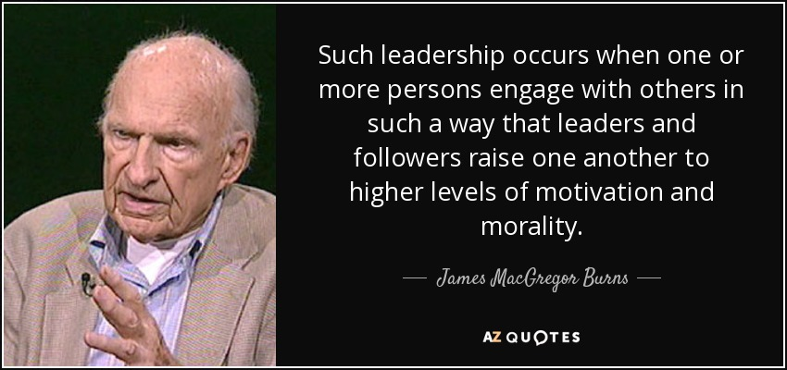
“LEADING FOR CHANGE IS NOT THE SAME AS EXERCISE OF POWER.”
-George McGregor Burns-
Notes:
We know that “leading for change is not the same as the exercise of power” (George McGregor Burns, LEADERSHIP 9-28).
Christian leaders don’t point loaded guns to the heads of the followers, to get them to do things they might not otherwise do. That is not practicing leadership; it is exercising power.
True leadership only exists if people follow when they have the freedom not to.

Slide 30

LEADERSHIP IN FAITH COMMUNITIES…
THE TRANSFERENCE OF VISION!
Notes:
These visionary leaders find ways to transfer these dreams to their people. They understand that the test of true leadership is the transference of vision.

Slide 31
Good and godly people and a younger generation of Christians most often collide with their leaders over MISSION, VISION, VALUES, PRIORITIES, PLANS,
STRUCTURE AND PROGRAMS.
Notes:
SEE SLIDE: GOOD AND GODLY PEOPLE AND A YOUNGER GENERATION OF CHRISTIANS MOST OFTEN COLLIDE WITH THEIR LEADERS OVER MISSION, TRADITIONS VISION, VALUES, PRIORITIES AND PROGRAMS IN A FAITH COMMUNITY!

Slide 32
?
How do we LEAD
decisively and faithfully
when tensions arise
over change & transitions?
Notes:
So how do we lead with the mind of Christ when tensions arise over change and transitions?
The role of the visionary leader is to engage the congregation in shaping the new vision, and affirm passionately the core convictions.
Where do these disagreements and collisions take place most often in a local church?
Consider the following Lifespan graph of faith communities.

Slide 33
Change is inevitable.
Problems arise in the
TRANSITIONS.
We want and need for these transitions to be transformative; not destructive and divisive.
Notes:
CHANGE IS INEVITABLE.
PROBLEMS ARISE IN THE TRANSITIONS.
WE WANT AND NEED FOR THESE TRANSITIONS TO BE TRANSFORMATIVE;
NOT DESTRUCTIVE AND DIVISIVE.

Slide 34

Anchor # 1:
Speak Gracefully
—Ephesians 4:29—
Issue:
“Watch the words we speak”
Principle:
Words we speak can bless
or “destroy” people
Notes:
Anchor #1: SPEAK GRACEFULLY. Ephesians 4:29
Issue: “Watch the words we speak.”
Principle: Words we speak can bless or “destroy” people.

Slide 35
As leaders, through the words
we use, we either:
    Encourage or discourage…
Lift them up or put them down…
Speak positively or negatively…
Focus on “them” or focus on self.
Notes:
“What comes out of my mouth reflects what is in my heart,” so Jesus states in the Gospels.
As leaders through the words we use, we either:
Encourage or discourage those with whom we work.
Lift them up or put them down.
Speak positively or negatively about them.
Reflect cultural sensitivity or cultural “blindness” to them.
Focus on “them” or focus on self.

Slide 36
?
How do others feel
when they leave my presence?
Stronger or weaker?
Larger or smaller?
Confident or “scared”?
Understood or misunderstood?
Affirmed or manipulated?
  Blessed or “destroyed”?
Notes:
I often ask myself: how do others feel when they leave my presence?
Stronger or weaker?
Larger or smaller about themselves?
Confident or “scared”?
Understood or misunderstood? Affirmed or manipulated?
Blessed or “destroyed”?

Slide 37
PRAISE to CRISTICISM ratio
80-90%
praise or positive statements
10-20%
criticism or negative statements
-Sven Walroos, clinical psychologist.
Notes:
“The praise to criticism ratio with others with whom we work should be at about 80-90% praise or positive statements to 10-20% criticism or negative statements.” Good advice from Sven Walroos, Scandinavian clinical psychologist.
According to Ephesians 4:29, God uses the words we speak to others within the Body of Christ to extend His grace through us to them!
What a powerful and probing thought!
Remember, the words we speak to those with whom we work especially those who differ and even collide with us, can bless them or destroy them.
Choose to bless them!

Slide 38
Anchor # 2:
Live Gratefully
—1 Thessalonians 5:18—
Issue:
Comparison is the root of inferiority
Principle:
“Don’t complain. Be grateful”
Notes:
READ SLIDE AND SCRIPTURE PASSAGE

Slide 39
COMPARISON
robs us of joy, relationships, confidence and peace.
In the process,
it saps our energy
and drains us of enthusiasm.
Notes:
Comparison is so pervasive in our society – in the workforce, the family, the local church or region, in our communities and particularly within ourselves.
We can feel good about ourselves – our gifts, talents and abilities – until we compare ourselves with the gifts, talents and abilities of other people.
We can believe our co-workers are adequate for the jobs we give to them until we compare their work – creativity, innovation, energy, collegiality – with others.
COMPARISON ROBS US OF JOY RELATIONSHIPS, CONFIDENCE AND PEACE.
IN THE PROCESS IR SAPS OUR ENERGY AND DRAINS US OF ENTHUSIASM.

Slide 40
Gratitude is the
“life-giving” antidote
to the negative impact
of comparison
Notes:
Comparison can transform us from being a delightful district leader or local church pastor into a preoccupied, dejected, negative and disgruntled individual that other people only endure.
What is the antidote to comparison? Gratitude! Thankfulness! Appreciation!
We can choose to accept the people and provisions God in His wisdom has given to us.
We can choose to bring out the best in others through seeing the best in them.
In every situation, we can choose to be grateful, believing that God is in the midst of all that we are doing (I. Thessalonians 5:18).
Gratitude is the “life-giving” antidote to the negative impact of comparison.

Slide 41
Anchor # 3:
Listen Intently
—James 1:19—
Issue:
“Seek first to understand”
PRINCIPLE:
Understanding, not agreement,
is the key to conflict management
Notes:
READ SLIDE AND SCRIPTURE PASSAGE
As a leader I may be a good administrator. However, I must be a great listener.
James 1:19 admonishes us to “quick to listen, slow to speak…!
I can listen for understanding. And listen for what is said. Also, I need to listen for what is not said.
Listening to the people with whom I work values them. They deserve to be heard. They may have the spiritual gifts needed to move the vision to action.
Remember, understanding not agreement, is the key to conflict management.

Slide 42


Theological vision
precedes
organizational vision.
Notes:
“Holiness people can have honest and intense differences.
I can tell you, after 35 years in higher education administration that good and godly people and a younger generation of Christians sometimes collide with their leaders over vision. And you have similar testimonies!
This is why I have come to see that theological vision (what I believe about people / what I “see” in them)
precedes organizational vision. ***(What I want for the church, district, field or region.)
“God give me your eyes to really ‘see’ the people with whom I work.”

Slide 43
Growth producing questions:
  “What can I learn?”
  “How can I change?”
Growth inhibiting questions:
  “Why me?”
  “What if…?”
Notes:
In conflict situations with Christians in our congregations, I have learned to ask two growth-producing questions:
“What can I learn? How can I change?”
Likewise, I have learned at least two growth-inhibiting questions:
“Why me? What if…?”
The questions make the difference in the outcomes: I, as the leader, can learn and change, even if others do not.

Slide 44
Anchor # 4:
Forgive Freely
— Luke 23:34 —
Issue:
Be proactive in extending forgiveness
PRINCIPLE:
A spirit of forgiveness transforms
and empowers leaders
Notes:
One of my profound life lessons is this: forgiveness has little to do with the external environment around me, and everything to do with my “internal” condition!
Extending forgiveness does not wait for the “other” to request forgiveness. Remember the example of Jesus on the cross: “Father, forgive them, they know not what they do.”
Was Jesus naïve? Did he really believe that those who were killing him did not know what they were doing? No!
Did Jesus believe that by extending forgiveness, those who were slandering him and hurting him would cease their activity? No!

Slide 45
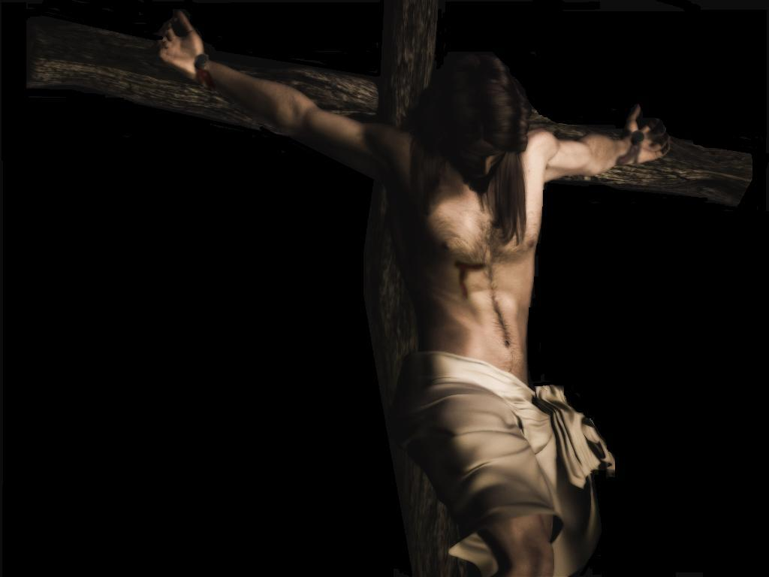
“Father, forgive them, for they do not know what they are doing.”
Luke 23:34 (NIV)
Notes:
Jesus was not going to permit what others said against him or the evil they did against him to create a bitterness or resentment within him and thereby create a rupture on the relationship with God His Father. It simply was not worth it!
“Father, forgive them, they know not what they do!”
Extending forgiveness frees me from bondage to the other person. Too often, we permit persons who have offended us to control us.

Slide 46
Anchor # 5:
LEAD Decisively
— Romans 12:8c —
ISSUE:
Christian leaders combine deep humility,
clear vision, and intense resolve
PRINCIPLE:
Our holiness testimony is reflected in and through the way we make and implement decisions
Notes:
READ SLIDE AND SCRIPTURE.
It is in the tension within a faith community between our preferred future and the present reality that our decision making as leaders most often takes place.
It is in this context that we live, work and lead.
If holiness of heart does not reflect itself in these situations where good and godly people differ over vision and values, then our holiness testimony is only a doctrine and not a Life within us!
Respecting our brothers and sisters in Christ, especially those with whom we differ— even collide with us—is at the heart of what it means to lead with the Mind of Christ.
It is in these times of conflict over vision and values that decisions will need to be made —even when continuing differences exist. And, in these times, we will lead—lead decisively—but from our knees and often with a weeping heart!
Again, at some point in our leadership responsibilities, decisions have to be made. Decisions made after prolonged individual and collective prayer. Decisions made with fierce resolve and deep humility.

Slide 47
They give passionate attention
to the leadership roles of:
Dreaming and planning
Organizing and administering
Motivating and encouraging
Evaluating and reviewing
Notes:
Pastors are the catalysts for evangelism and discipleship, change and action in the local congregation.
If decisive leaders are to move from the preferred vision to achieved results, they must give passionate attention to the leadership roles of:
Dreaming and planning. Organizing and administering. Motivating and encouraging. Evaluating and reviewing.
The apostle Paul challenges us, “if (your gift) is leadership, let him govern diligently” (Romans 12:8c)

Slide 48
PLANNING CYCLE
1.Understand your mission:
OVERARCHING
MISSION STATEMENT
PLANNING CYCLE
4. Implement
your plan:
COMPREHENSIVE IMPLEMENTATION PLAN
Continually review and revise your strategy
REVIEW AND REVISE
2. Assess your situation:
SITUATION ASSESSMENT
3. Develop your goals:
PERSONAL PROFESSIONAL GROWTH GOALS
Notes:
Let’s focus for a few moments only on the critical leadership function of dreaming and planning.

Slide 49
We move ahead – decisively – through:
PRAYER, with them, for them, and for “me” as leader;
COLLABORATION, involving them when and where we can in the process; and with
GRATITUDE, thanking God, and “them” for their gifts, talents, abilities and testimonies of faith.
Notes:
Sometimes, perhaps often, we must move ahead without everyone within the community agreeing with the vision or direction to be taken.
How do we move ahead, decisively, in these painful situations while, at the same time, show Christian respect to those who differ with us? We move ahead decisively –
THROUGH prayer, with them, for them and for “me” as leader;
THROUGH collaboration, involving them when and where we can in the process;
and WITH GRATITUDE, thanking God, and “them” for their gifts, talents, abilities and testimony of faith in Jesus as Lord.
In this spirit of humility and brokenness, we move ahead:
Confidently – believing that God is working in the midst of this difficult situation, and decisively, not with paralysis or uncertainty, but with the conviction that God has spoken his word of vision and direction. A conviction that He will continue to lead His people to action even though the circumstances or attitudes may not give evidence of His work at the present time.
This is leading with the mind of Christ – leading decisively in the midst of complex and difficult situations.
Remember, the BIG question for Christian leaders: “How can my ministry of Christian leadership enable others to fulfill their ministry to each other and their mission in the world?”

Slide 50
Anchor # 6:
Love Deeply
—1 Thessalonians 2:7—
ISSUE:
Value people not power (or position)
PRINCIPLE:
The evidence of leadership is seen
in the lives of the followers
Notes:
read slide and scripture.
Caring for others is the mark of greatness, not decisiveness. Paul reminds his follows in I Thessalonians 2:7 that “we were gentle among you, like a mother caring for her little children.”

Slide 51
Leaders who inspire others…
#1. Set Clear Standards
(or Expectations)
#2. Expect the Best
#3. Pay Attention
#4. Encourage People
#5. Tell the Story
#6. Celebrate Together
#7. Set the Example
ENCOURAGING THE HEART
James Kouzes and Barry Posner
Notes:
One book on encouraging those with whom we work tells us how to encourage the hearts of our co-workers:
#1. Set Clear Standards
#2. Expect the Best
#3. Pay Attention
#4. Encourage Often
#5. Tell the Story.
#6. Celebrate Together.
#7. Set the Example.
See other suggestions in the book, ENCOURAGING THE HEART by Kouzes and Posner

Slide 52
Anchor # 7:
Pray Earnestly
— 1 Thessalonians 5:17 —
Issue:
Some issues are only resolved through prayer
And dependance on God
Principle:
Recognize that God can work in us
to become the change we desire to see in others
Notes:
READ SLIDE AND SCRIPTURE
Holiness leaders know that we do not have the power to change others. Change can take place, however, within us!
In the midst of experiencing honest and intense differences between good and godly people, the “pray-er” can be changed and transformed!
Conflict situations can produce growth. They can also inhibit growth in the lives of leaders.
Before God in prayer, we seek answers from Him to these two questions: what can I learn; how can I change?

Slide 53
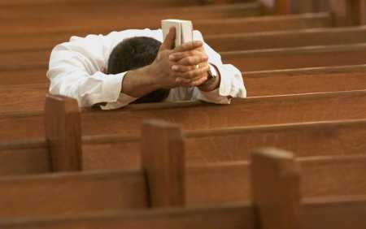
In the midst of experiencing honest
and intense differences
between good and godly people, the “pray-er” can be changed and transformed!
Notes:
In so asking, and seeking God’s answers to these two questions for our lives as leaders, we are changed! Increasingly, we become the change, by God’s grace, we desire to see in others.
Others around us may or may not be impacted by what happen within us. But, what happens to us is transformative!
We grow. We change. We mature. We increasingly exemplify the change we desire to see in others!
And, in the process, we experience the peace of God which transcends understanding. In the process, we are “freed” from insisting on change within others.
Through earnest prayer, caring leaders asks the right questions, and trust God with the results...even as we are changed in the process! Amen!

Slide 54
“TEACHERS with the mind of Christ seek humbly to TEACH others, for the purpose of inspiring and enabling them, through mentoring and modeling, to live their lives under the Lordship of Christ, and to understand, accept, and fulfill their ministry to each other, and their mission in the world.”
Notes:
“Leaders with the mind of Christ seek to humbly lead others, for the purpose of inspiring and enabling them, through teaching and example, to live their lives under the Lordship of Christ, and to understand, accept, and fulfill their ministry to each other, and their mission in the world.”
ELF- Definition of Christian Servant Leadership

Slide 55
Anchors hold the servant leaders steady in the tensions and transitions in our leadership responsibilities:
1. Speak Gracefully. Watch our words
2. Live Gratefully. Don’t complain, be grateful
3. Listen Intently. Seek first to understand
4. Forgive Freely. Be proactive in forgiving
5. Lead Decisively. With vision, humility and resolve
6. Love Deeply. Value people, not power
7. Pray Earnestly. Become the change
Notes:
“Leaders with the mind of Christ seek to humbly lead others, for the purpose of inspiring and enabling them, through teaching and example, to live their lives under the Lordship of Christ, and to understand, accept, and fulfill their ministry to each other, and their mission in the world.”
ELF- Definition of Christian Servant Leadership

Slide 56
Question #1
?
Which of these seven anchors
is your greatest strength?
Notes:
IN CONCLUSION
I leave you with these questions:
Which “Anchor” is your strength? Be honest with yourself and God.
It’s vitally important for us to affirm our strength even as we acknowledge our need.
Build on your strength.

Slide 57
Question #2
?
On which one of these “anchors” do you need most to focus in your leadership ministry of teaching?
Notes:
Which one of these “essentials” or “anchors” do you need most right now in your leadership assignment? Work on your need.
Pray for that specific anchor you need, and give thanks for strength He has given to you as you lead your people from vision to action to results.
As you experience the tension between the vision God has given you and the reality of your present situation, in which of these areas do you most need God to hold you steady?
As you embrace tension and transitions and move from vision to results, what is your greatest need?

Slide 58
Question #3
?
What difference would it
make in your ministry if
you intentionally embrace
this anchor?
Notes:
ONE MORE QUESTION. WHAT DIFFERENCE WOULD IT MAKE IN YOUR MINISTRY IF YOU INTENTIONALLY EMBRACE THIS (WEAK) ANCHOR?

Slide 59
Our testimony of faith in
Jesus Christ must increasingly inform and transform the way
we teach and lead
in our homes, classes,
and organizations.
Notes:
AS CHRISTIAN LEADERS, “OUR TESTIMONY OF FAITH IN JESUS CHRIST MUST INCREASINGLY INFORM AND TRANSFORM THE WAY WE LEAD AND LIVE IN A FAITH COMMUNITY”

Slide 60
Discuss these questions and the Seven anchors in “break-out" groups

Slide 61
How to Nurture
Leadership Character
The challenge of communicating this leadership lifestyle to emerging leaders
Session Three

Slide 62
Four Questions
Mentoring and Modeling Leadership Character
1. How can we live together in such a way that our relationships are redemptive and a witness to unbelievers of the reconciling work of God in Christ?
2. If, in Christ, all things are made new, then how does our relationship to Christ convert the way we lead (and teach) in a community of faith?

Slide 63
Four Questions
Mentoring and Modeling Leadership Character
3. In conflict situations, when good people differ and sometimes collide over vision, values, traditions, policies, and programs, how can I lead in these situations, really lead (and serve) with the mind and spirit of Christ?
4. How does my Christian testimony transform the way I both mentor others in the Christian faith and model before them a vibrant, maturing Christian life?

Slide 64
Let’s review:
For the students and faculty you lead, you can become leadership role models who exemplify, in word and deed, the very character qualities and values you most admire in others.
The Thesis of Chapter Three
Mentoring and Modeling Leadership Character

Slide 65
Leadership
Mentoring and Modeling Leadership Character
Let’s review:
Leadership begins with humble service to others
to enable them, through teaching and example,
to live their lives under the Lordship of Christ,
to understand, accept, and fulfill
their ministry to each other and
their mission to the world.

Slide 66
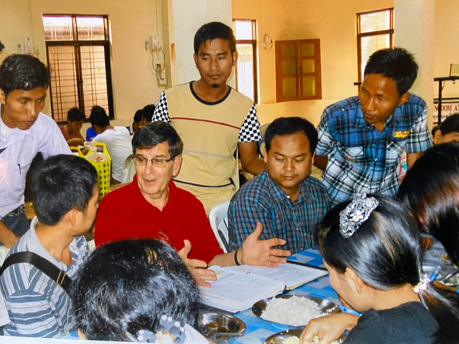
How can we lead and work with students or colleagues in such a way that they grow in this process?

Slide 67
The Big Questions
Mentoring and Modeling Leadership Character
How do we communicate this leadership lifestyle to future leaders?
How do we teach commitments, priorities, values, and disciplines? How do we teach a lifestyle?
Whatever else it means, it demands we take seriously the principle of IMITATION, or MODELING.

Slide 68
Nurturing Leadership Character
Through the Theological Dynamics and Disciplines of Hospitality, Acceptance, and Presence.
Dynamic #1: Hospitality
Making Room: Recovering Hospitality in Christian Tradition

Slide 69
“Hospitality primarily means the creation of free space - making room - in the midst of differences of thought or behaviors that may exist.”
Christine Pohl, Making Room: Recovering Hospitality in Christian Tradition
Nurturing Leadership Character
Dynamic #1: Hospitality
It is being to others … a living witness of the risen Christ.
Hospitality - “creating space and making room for the strange and the stranger.”

Slide 70
Fundamentally, it is a core attitude toward others.
Nurturing Leadership Character
Dynamic #1: Hospitality
Hospitality, biblically understood, challenges us
to relate to others
as if we were relating to Christ Himself.

Slide 71
“The gift of Christian hospitality is the opportunity we provide for the colleague, co-worker, guest, stranger, family member or friend to find her or his own way. It enables us to consider an alternative way of thinking from those who may be very different from us. This gift to others invites them to contribute insights derived from these unique gifts and abilities, even in the context of differences of thought and behavior.”
Nurturing Leadership Character
Dynamic #1: Hospitality

Slide 72
Nurturing Leadership Character
Through the Theological Dynamics and Disciplines of Hospitality, Acceptance, and Presence.
Dynamic #2: Acceptance
“What John 3:16 is to the non-Christian,
Romans 15:7 is to the Christian.” Duane Elmer
“Accept one another then, just as Christ accepted you,
in order to bring praise to God.” Romans 15:7

Slide 73
“Acceptance is the ability to communicate value, regard, worth, and respect to others.
It is the ability to make people feel significant, honored, and esteemed.”
Duane Elmer
Nurturing Leadership Character
Dynamic #2: Acceptance

Slide 74
Acceptance of others, as defined, does not imply acceptance of their ideas or behavior.
Nurturing Leadership Character
Dynamic #2: Acceptance
Listening attentively to them and accepting them as persons created by God and thus worthy of our regard and respect are critical first steps toward an encounter that is transformative.

Slide 75
“Leadership is known by the personalities it enriches, not by those it dominates or captivates.” Harold Reed
“Leading for change is not the same as exercise of power.”
George McGregor Burns
Nurturing Leadership Character
Dynamic #2: Acceptance

Slide 76
All Christians — even those who sometimes make life difficult — are called and gifted for the ministry of Christ.
Nurturing Leadership Character
Dynamic #2: Acceptance
They remain our responsibility — demanding keen insight, deep caring, and Spirit-empowered understanding.

Slide 77
Nurturing Leadership Character
through the Theological Dynamics and Disciplines of Hospitality, Acceptance, and Presence.
Dynamic #3: Presence
“… but what the leader brings in his/her presence. And the presence he/she needs is a non-anxious presence.”
Edwin Friedman

Slide 78
“Caring deeply” demands that we listen intently, speak directly and caringly, ask questions for the other person’s sake, and not for our own.
Nurturing Leadership Character
Dynamic #3: Presence
The people with whom leaders live and work … more often need from their leaders their presence.

Slide 79
Good people often see things differently from the leader.
Insights on Christian spirituality and leadership
Mentoring and Modeling Leadership Character
Many issues over which we experience conflict are based culturally, ethnically, or in the family, and are not violations of scripture.
Differences that divide us have the potential to alienate members of the body of Christ and to negatively impact the work of God in our communities.

Slide 80
Caring for others who differ with us is to love, respect, and honor them, as God loves them.
Insights on Christian spirituality and leadership
Mentoring and Modeling Leadership Character
Acceptance of others implies that we can learn from them.
We must find ways to communicate acceptance to those who are not yet Christ-followers.

Slide 81
The theological dynamics of hospitality, acceptance, and presence are significant means to the end of mentoring and modeling leadership character in the lives of those we lead.

Slide 82
Will this action strengthen me spiritually?
7 Questions regarding Christian Character Development
Mentoring and Modeling Leadership Character
Would I want my child, my spouse, or my best friend to copy this action of mine?
Does this action violate a biblical principle?
Does this action strengthen the body of Christ?
Would an unbelieving friend be attracted to Christ and the Christian faith by my behavior?
Do my negative attitudes affect other people?
If this happens, what will I do to change this type of behavior in my life?

Slide 83
1. Speak Gracefully. Watch the words I speak. “I want my words to be grace-giving, life generating and inspiring to others and not discouraging, depressing and draining utterances.”
2. Live Gratefully. Don’t complain. Be Grateful. “I want to be known as a person who is forever grateful, regardless of the situation, believing that God is in the midst of everything I do and is working to bring good our of the situation.”
3. Listen Intently. Seek First to Understand. “I want to listen to and respect the people with whom I work, to understand them – and for them to understand me – even if we do not agree with each other.”
4. Forgive Freely. A Spirit of forgiveness transforms and empowers. “I want to initiate forgiveness when I have been offended because I don’t have the energy or strength to carry the heavy burden and guilt of an unforgiving spirit.”
My Leadership Credo
Mentoring and Modeling Leadership Character
My Leadership Credo

Slide 84
My Leadership Credo
Mentoring and Modeling Leadership Character
5. Lead Decisively. Combine clear vision, deep humility and intense resolve. “I want to lead with decisiveness with deep humility even when I experience the pain of holding tenaciously to the vision while acknowledging the realities of my situation.”
6. Love Deeply. Value people not power. “I want my relationship with others to energize them, to have a positive impact on their lives and to enable them, in some small way, to grow – become stronger – in their faith, their confidence in themselves and their competence at work as a result of our interaction in the home and on the job and with me as leader.”
7. Pray Continuously. Become the change you want to see in those you lead. “I want to pray earnestly so that in the midst of conflict between the leader and the led, what happens to both of us is transformative!”
“My Leadership Credo” is from Mentoring and Modeling Leadership Character. Fairbanks. Chapter Four. (Pages 54-55)

Slide 85
In “breakout” sessions, please share key insights you have gained from these sessions regarding nurturing leadership character in yourself and /or in others you teach and lead.
Reflections on the Three Sessions
Mentoring and Modeling Leadership Character

Slide 86
Remember:
For the students and faculty you lead, you can become leadership role models who exemplify, in word and deed, the very character qualities and values you most admire in others.
The Thesis of these Sessions
Mentoring and Modeling Leadership Character

Slide 87
BOOK
AVAILABLE
AT AMAZON
Kindle & Paperback Editions
bit.ly/MMLC-ELFairbanks

Slide 88

Dr. Edward LeBron Fairbanks
lfairbanks@boardserve.org
www.boardserve.org
https://mvnu.whdl.org/collections/dr-e-lebron-fairbanks-collection

